Slide 1

Web Application Security
Security, XSS, SQL Injection, CSRF, Parameter Tampering
SoftUni Team
Technical Trainers
Software University
https://softuni.bg

Slide 2
Table of Contents
Common security problems
Cross-Site Scripting (XSS)
SQL Injection
Cross-Site Request Forgery (CSRF)
Parameter Tampering

Slide 3
Have a Question?
sli.do #csharp-web

Slide 4

Common Web App Security Problems
XSS, SQL Injection, CSRF, Parameter Tampering

Slide 5






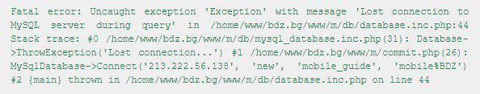
Most Common Web Security Problems
SQL Injection
Cross-site Scripting (XSS)
URL/HTTP manipulation attacks (Parameter Tampering)
Cross-site Request Forgery (CSRF)
DoS, DDoS and Brute Force attacks
Too much information in Errors
Security flows in other software we use
Dev
https://owasp.org/Top10
https://www.exploit-db.com

Slide 6
Other Security Threats
Semantic URL/HTTP attacks (URL/HTTP manipulation)
Always validate the data on the server-side
Man in the Middle (Always use SSL)
Insufficient Access Control
Other types of data injection (Always sanitize data)
Phishing and Social Engineering (Educate your users)
Security flows in other software we use (Use latest versions)

Slide 7
Security Fundamentals
There is a wide range of known types of threats and attacks
There is an even wider range of unknown threats and attacks…
Category | Threats / Attacks
Input Validation | Buffer overflow, cross-site scripting, SQL injection, canonicalization
Parameter Tampering | Query string manipulation, form field manipulation, cookie manipulation, HTTP header manipulation
Session Management | Session hijacking, session replay, man-in-the-middle
Cryptography | Poor key generation or key management, weak or custom encryption
Sensitive Information | Access sensitive code or data in storage, network eavesdropping, code/data tampering, Admin password in exceptions
Exception Management | Information disclosure, denial of service

Slide 8
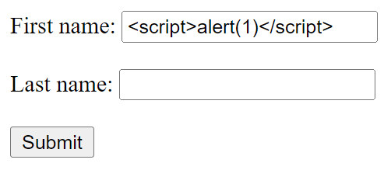
Cross Site Scripting (XSS)
Injecting Unsafe HTML Code (with Scripts)

Slide 9



What is Cross Site Scripting (XSS)?
XSS attacks enable attackers to inject client-side scripts into web pages viewed by users
Server XSS
Client XSS
Server
POST / comment.php? text=<script>alert(1)</script>
INSERT…
' <script>alert(1)</script> '
DB
<html>
…
Comments
<script>alert(1)</script>
…
</html>
Client 1
SELECT… =>
' <script>alert(1)</script> '
Client 2

Slide 10
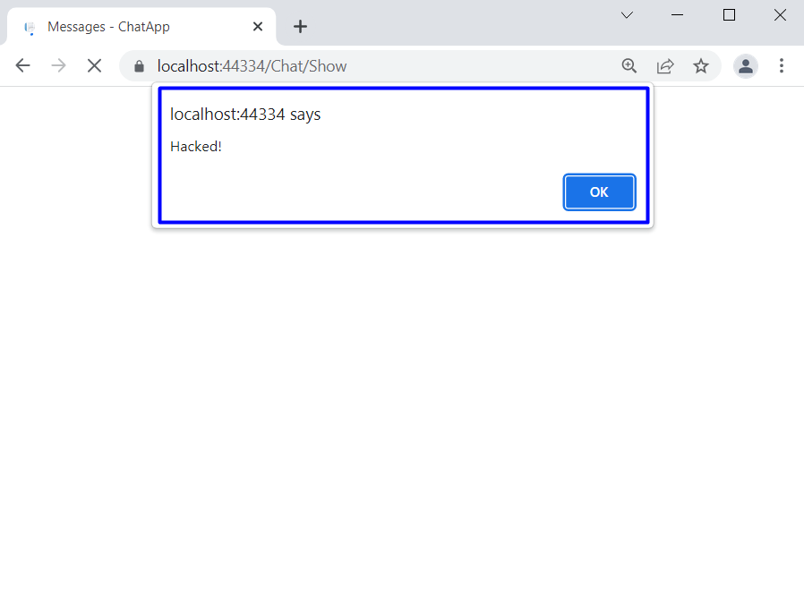
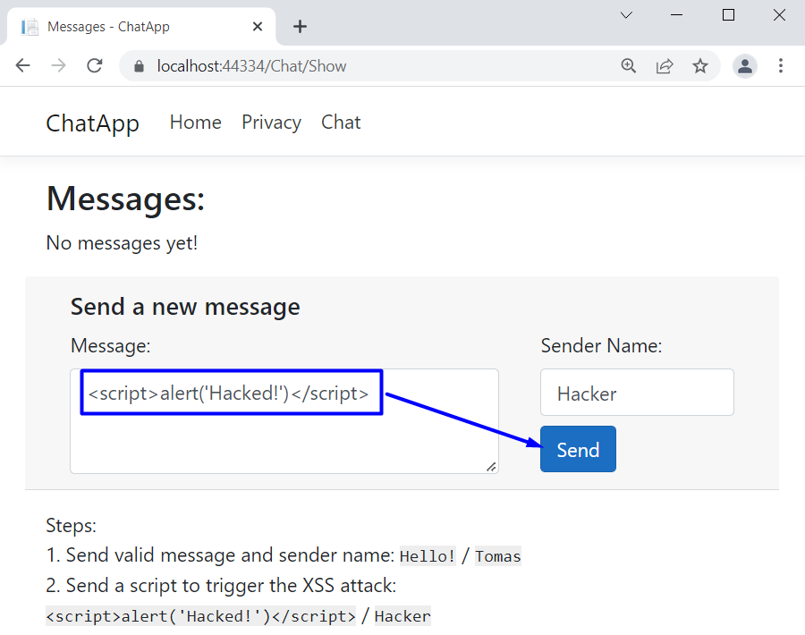
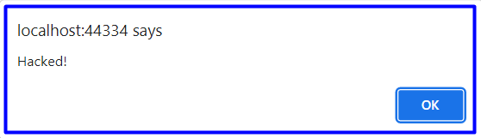
Cross Site Scripting (XSS) – Demo
We have a vulnerable ASP.NET Core chat app
User adds "<script> alert('Hacked!') </script>"
Then, a JS popup appears
Demo code: see the resources

Slide 11
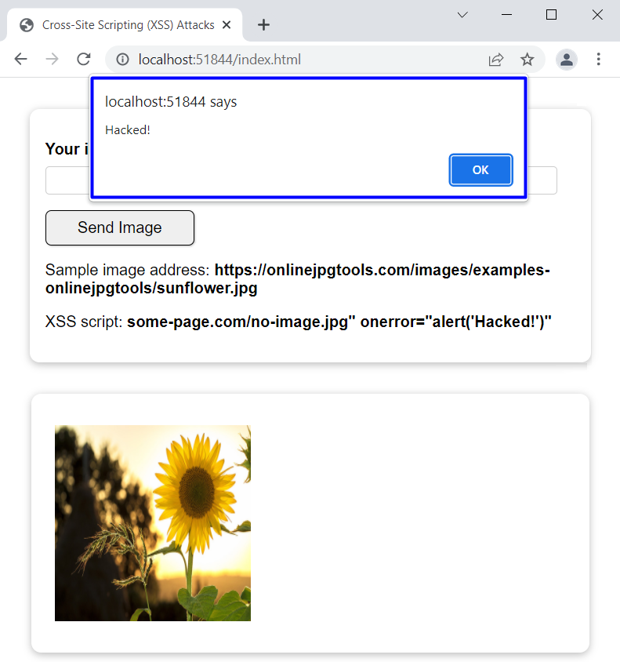
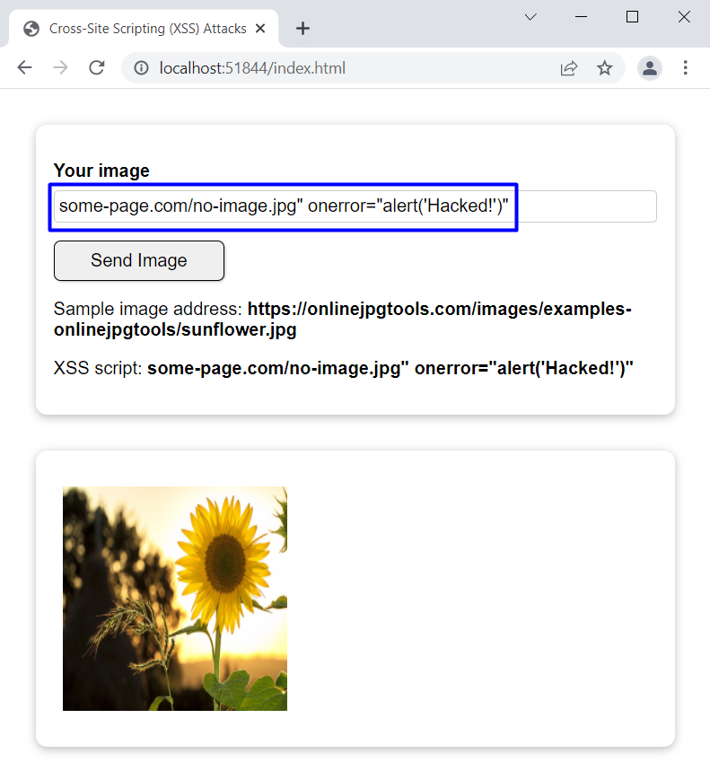
Cross Site Scripting (XSS) with Image – Demo
We have a vulnerable JS images app
User adds an invalid image URL and an onclick event with a JS script
Then, a JS popup appears
Demo code: see the resources

Slide 12
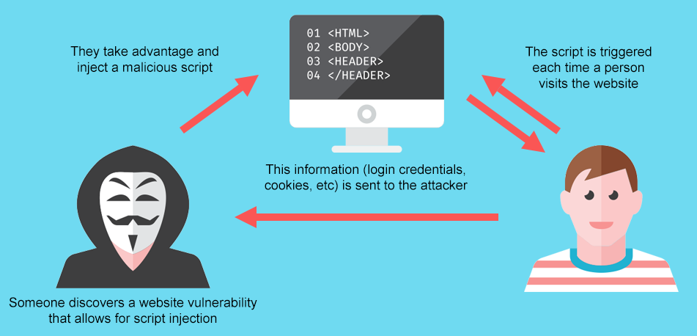
Why is XSS a Big Security Problem?
Attackers can:
Steal cookies, session storage, local storage, etc.
Impersonate you, e. g. "create a new admin user"
Perform actions on behalf of the user
Gain access to the user's sensitive data
Etc.

Slide 13
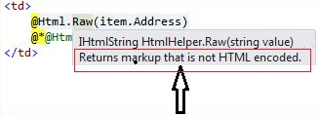
Protecting from XSS in ASP.NET MVC
The Razor view engine secures you against XSS by default
If you decide to break it – @Html.Raw(…)
There are several rules you must follow to be secured:
Never put untrusted data into your HTML output
Before putting untrusted data somewhere, ensure it is secured
Encoded, parsed, validated, checked for malicious contents
Untrusted data can be inputted anywhere in the application
URLs, HTML Elements, HTML Attributes, JavaScript code etc.

Slide 14
Protecting from XSS in ASP.NET MVC (2)
ASP.NET Core provides you with anything to secure your app
Razor automatically encodes all output sourced from variables
You can inject Encoders directly to your Views and use them
@{ var untrustedInput = "<\"script\">"; }
@untrustedInput
&lt;&quot;script&quot;&gt;
@using System.Text.Encodings.Web;
@inject JavaScriptEncoder encoder;
@{ var untrustedInput = "<\"123\">"; }
<script> document.write("@encoder.Encode(untrustedInput)"); </script>
<script> document.write("\u003C\u0022123\u0022\u003E"); </script>

Slide 15

Protecting from XSS in ASP.NET MVC (3)
You can also use ASP.NET Core Encoder Services
HtmlEncoder
JavaScriptEncoder
UrlEncoder
Alternatively, you can use the static methods
WebUtility.HtmlEncode and WebUtility.HtmlDecode
WebUtility.UrlEncode and WebUtility.UrlDecode
<"123">
&#x3C;&#x22;123&#x22;&#x3E;
<"123">
u003C\u0022123\u0022\u003E
<"123">
%3C%22123%22%3E

Slide 16
HtmlSanitizer
HtmlSanitizer is a .NET library for cleaning HTML fragments and documents from constructs that can lead to XSS attacks
https://github.com/mganss/HtmlSanitizer
Install the HtmlSanitizer NuGet package, then:
var sanitizer = new HtmlSanitizer();
var html = @"<script>alert('xss')</script><div onload=""alert('xss')"""
+ @"style=""background-color: test"">Test<img src=""test.gif"""
+ @"style=""background-image:
url(javascript:alert('xss')); margin: 10px""></div>";
var sanitized = sanitizer.Sanitize(html, "http://www.example.com");
Assert.That(sanitized, Is.EqualTo(@"<div style=""background-color: test"">"
+ @"Test<img style=""margin: 10px""
src=""http://www.example.com/test.gif""></div>"));

Slide 17
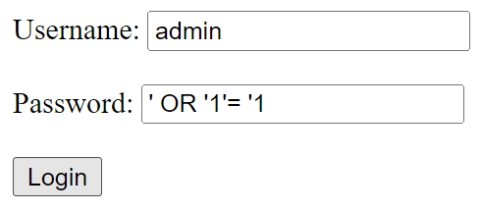
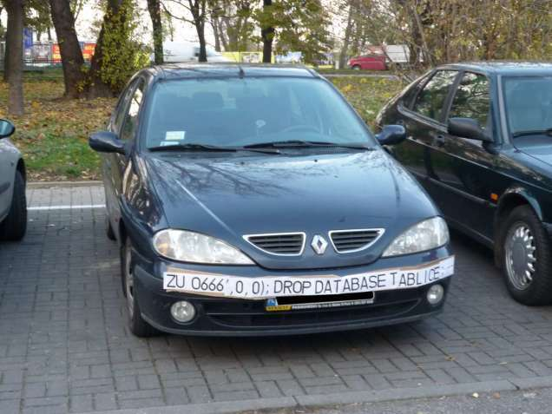
SQL Injection
Inject SQL Code in Unsafe Database Query

Slide 18
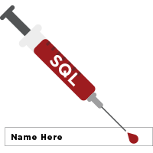

SQL Injection (1)
The following SQL commands are executed
Usual search (no SQL injection)
SQL-injected search (matches all records)
SQL-injected INSERT command
SELECT * FROM Messages WHERE MessageText LIKE ‘%JohnSnow%'"
SELECT * FROM Messages WHERE MessageText LIKE '%%%%'"
SELECT * FROM Messages WHERE MessageText LIKE '%' or 1=1 --%'"
SELECT * FROM Messages WHERE MessageText
LIKE '%'; INSERT INTO Messages(MessageText, MessageDate) VALUES ('Hacked!!!', '1.1.1980') --%'"

Slide 19
SQL Injection (2)
Original SQL Query:
Setting username to Admin & password to ' OR '1'= '1 produces
The result:
The user with username – "Admin" will login WITHOUT password
The pass query will turn into a bool expression which is always true
String sqlQuery = "SELECT * FROM user WHERE name = '" + username + "' AND pass='" + password + "'";
String sqlQuery = SELECT * FROM user WHERE name = 'Admin' AND pass='' OR '1'='1'

Slide 20
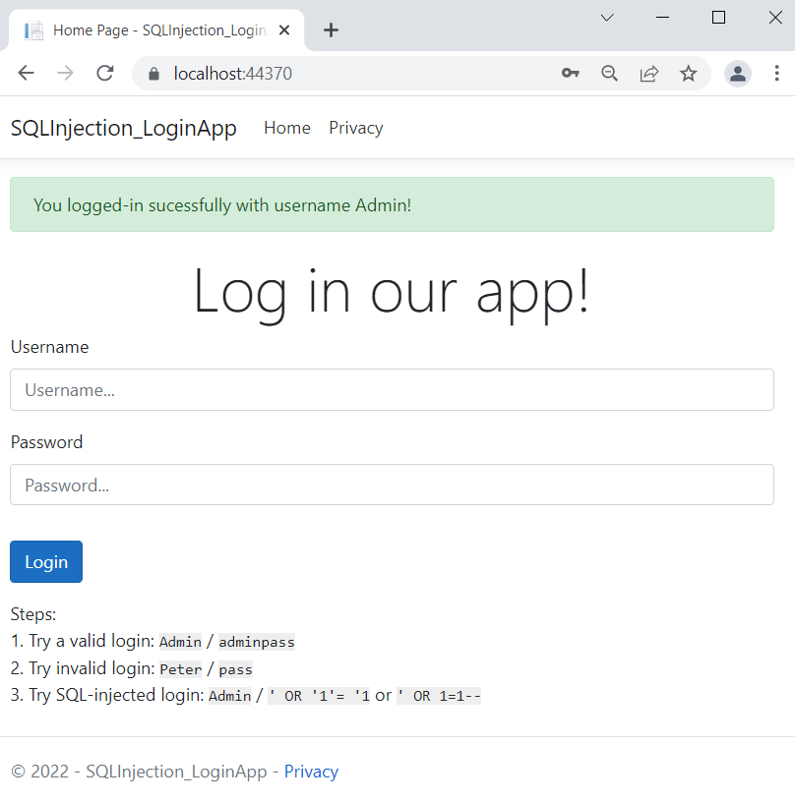
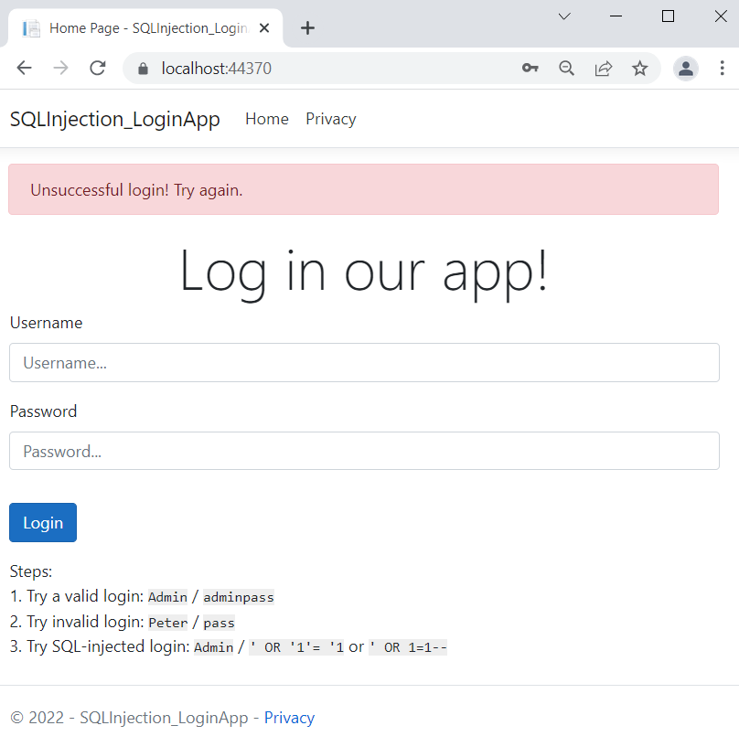
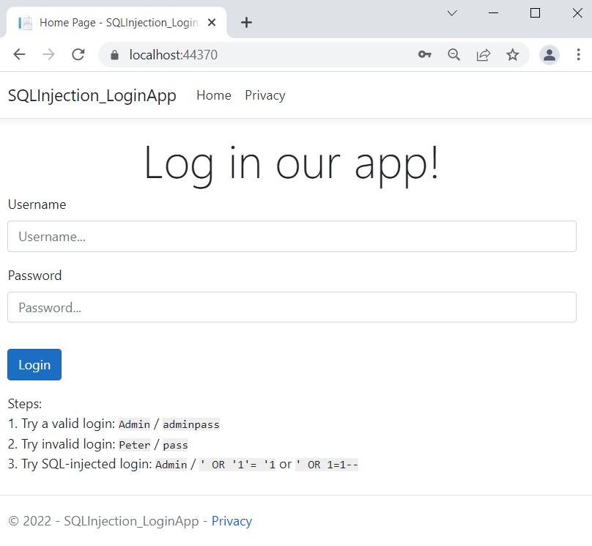
SQL Injection – Demo (Normal Workflow)
We have a simple app with an SQL-injectable login form
You can log in with "Admin" / "adminpass"
A success message appears
Other credentials are invalid
An error message appears

Slide 21
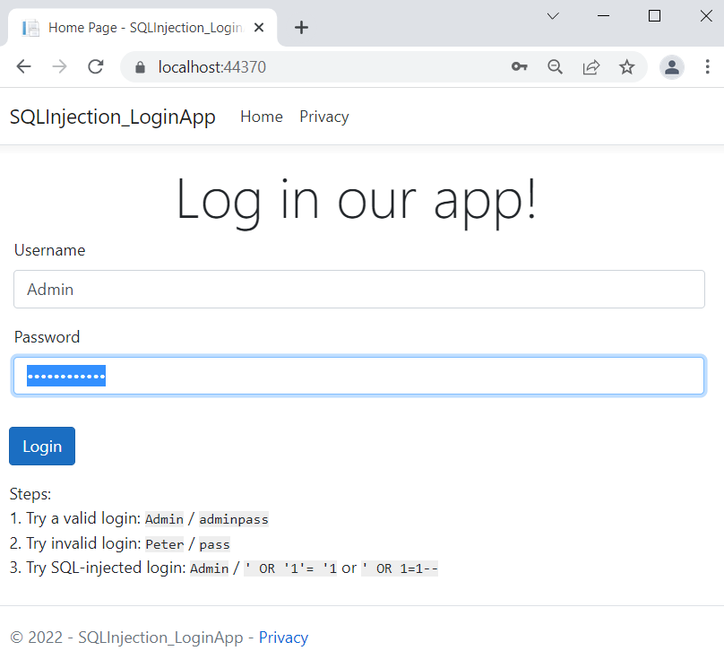
SQL Injection – Demo (2)
Use SQL Injection to log in with the "Admin" username and no password
Write ' OR '1'= '1 in the password field
Now you are successfully logged-in
Demo code: see the resources

Slide 22
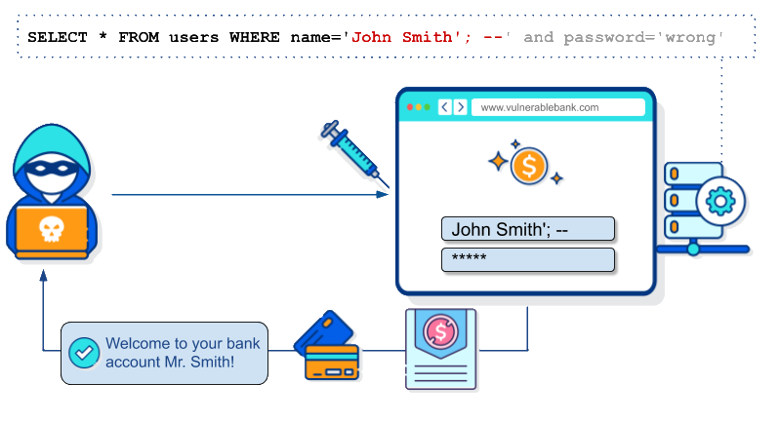
SQL Injection – How to Protect?
Don't concatenate SQL with "+"
Use parameterized SQL queries or stored procedures
Escape and sanitize all user input
Never connect to a database with an admin-level account
Don't store secrets in plain text
Exceptions should reveal minimal information

Slide 23
Protect from SQL Injection – Sample Code
SQL-injection vulnerable code:
The same code, rewritten correctly, with parameterized query:
string sqlQuery = "SELECT * FROM Users WHERE username = '"
+ user.Username
+ "' AND Password = '"
+ user.Password + "'";
var userExists = this.data.Users.FromSqlRaw(sqlQuery).Any();
if(userExists) …
else …
var userExists = this.data.Users
.Any(u => u.Username == user.Username && u.Password == user.Password);
if(userExists) …
else …

Slide 24
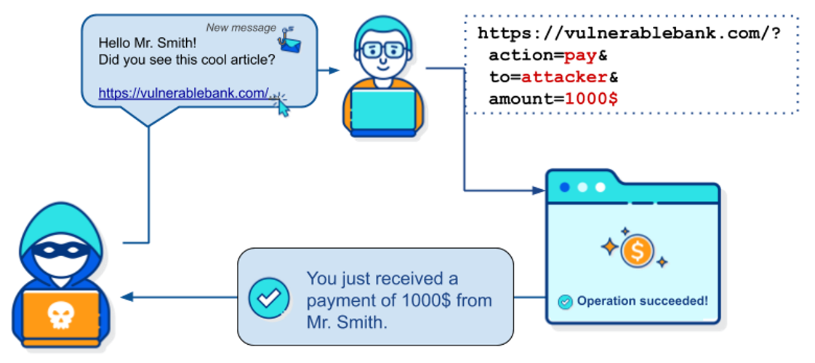
Cross-Site Request Forgery
Submit a Form on Behalf of Unsuspecting User

Slide 25

Cross-Site Request Forgery (1)
Cross-Site Request Forgery (CSRF / XSRF) is a web security attack over the HTTP protocol
Allows executing unauthorized commands on behalf of some user
By using his cookies stored in the browser
The user has valid permissions to execute the requested command
The attacker uses these permissions maliciously, unbeknownst to the user

Slide 26
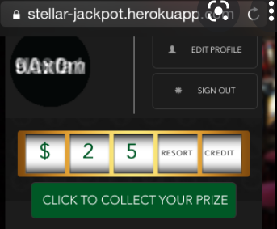

Cross-Site Request Forgery (2)
What Cross-Site Request Forgery actually is
The user can even misclick the button accidentally
This will still trigger the attack
Security against such attacks is necessary
It protects both your app and your clients
<!-- SOME MULTI-COLOR USELESS CLICKBAIT CONTENT --> <form action="http://good-banking-site.com/api/account" method="post">
<input type="hidden" name="Transaction" value="withdraw">
<input type="hidden" name="Amount" value="1000000">
<input type="submit" value="Click to collect your prize!">
</form>

Slide 27
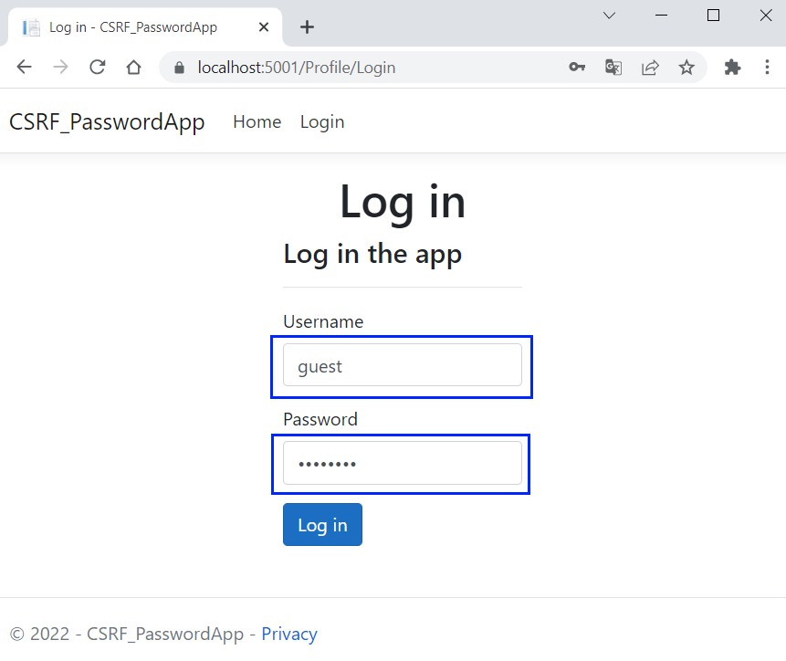
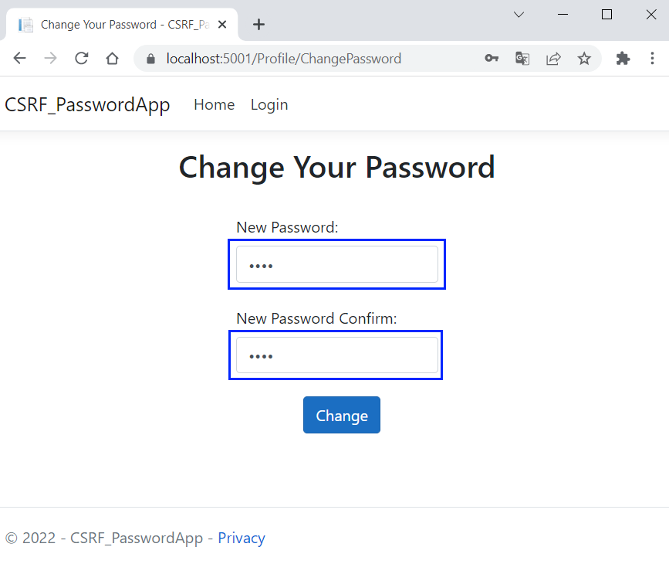
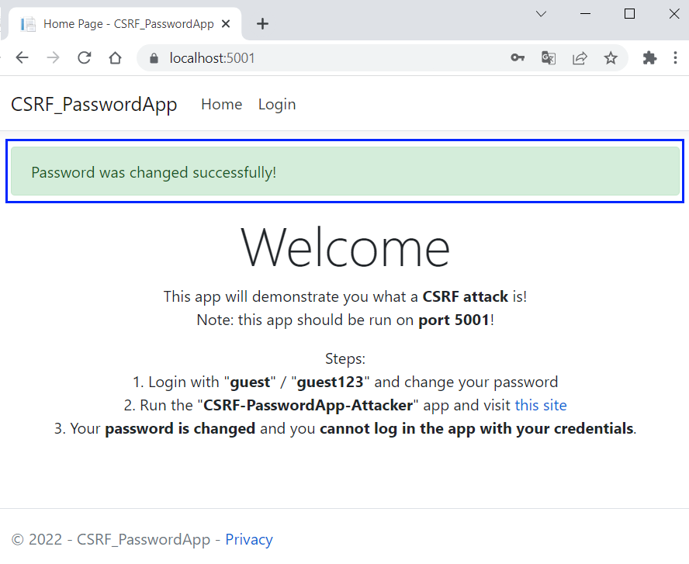
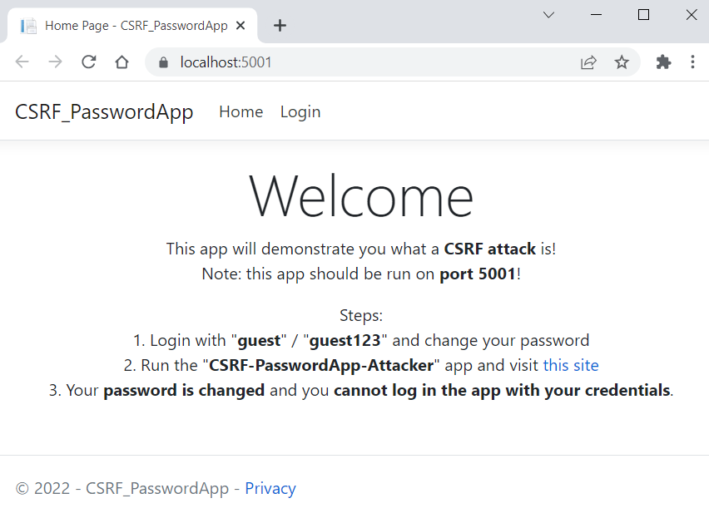
CSRF – Demo (Normal Workflow)
We have a very simple app, where users can login and change their password
Without protection for CSRF
Access the app on port 5001
Login with default user "guest" / "guest123"
Change the password
You will see a success message on the "Home" page
Now you can log in with your new password

Slide 28
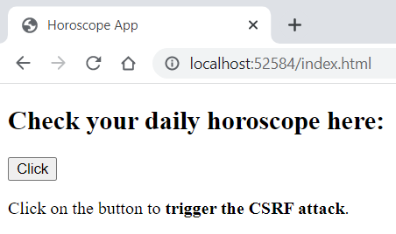
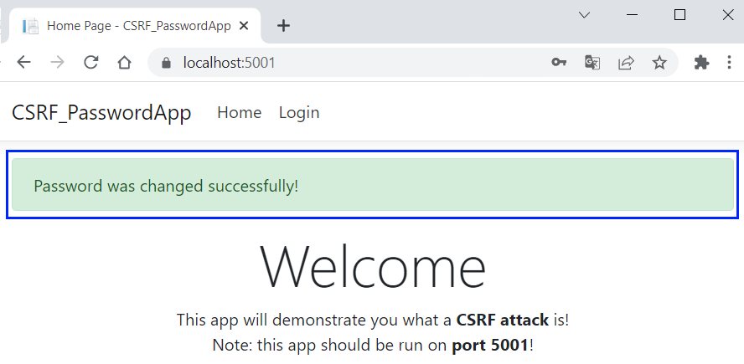
CSRF – Demo (Attack Workflow)
Visit the link on the "Home" page
It accesses a malicious site
Click on the [Click] button to trigger the attack
The malicious app changed your password through CSRF
Now you cannot log in with your credentials
Your password has changed to "hacked!"
Demo code: see the resources

Slide 29
AutoValidateAntiforgeryToken
The <form> tag helper in ASP.NET Core automatically adds a special hidden field to the form
It has a random value called anti-forgery token
Then you should require this token to be send
For a specific action
For all actions in given controller
Globally for the whole application
[AutoValidateAntiforgeryToken]
public IActionResult SendMoney(…) { … }
[AutoValidateAntiforgeryToken]
public class ManageController : Controller
services.AddMvc(options =>
options.Filters.Add(new AutoValidateAntiforgeryTokenAttribute()));

Slide 30
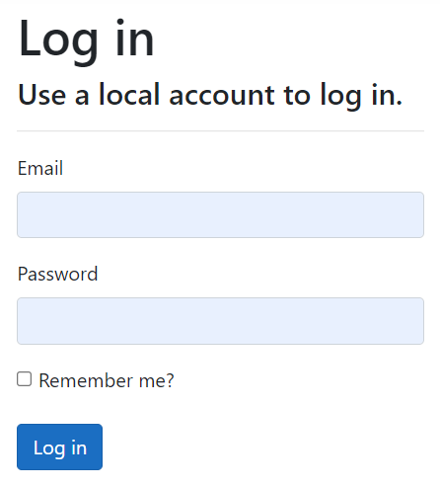
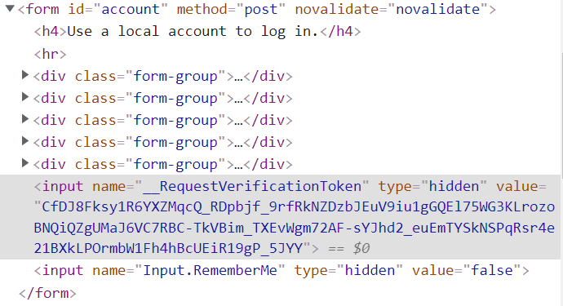
The Anti-Forgery Token in ASP.NET MVC

Slide 31
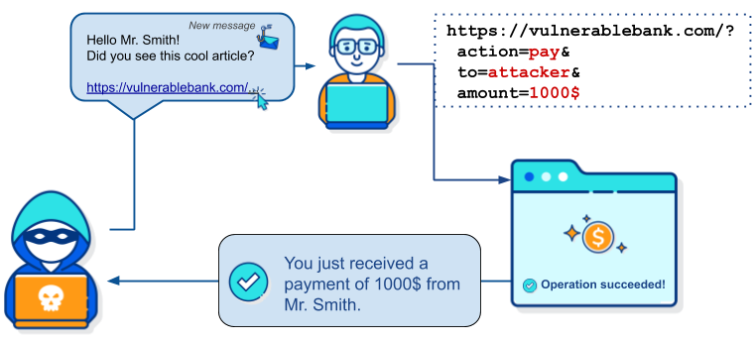
CSRF: How to Protect?
Use anti-forgery token
Include additional authentication for sensitive actions
Use the SameSite flag in cookies
Following a RESTful design
Enabling CORS protection
Set-Cookie: CookieName=CookieValue; SameSite=Strict;

Slide 32
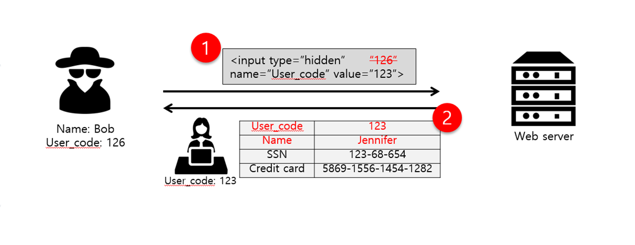
Parameter Tampering
Changing Input Parameters at the Client Side

Slide 33
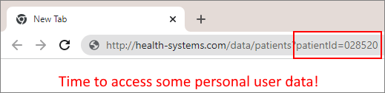
Parameter Tampering
Parameter Tampering is the manipulation of parameters exchanged between client and server
Altered query strings, request bodies, cookies
Skipped data validations, injected additional parameters

Slide 34
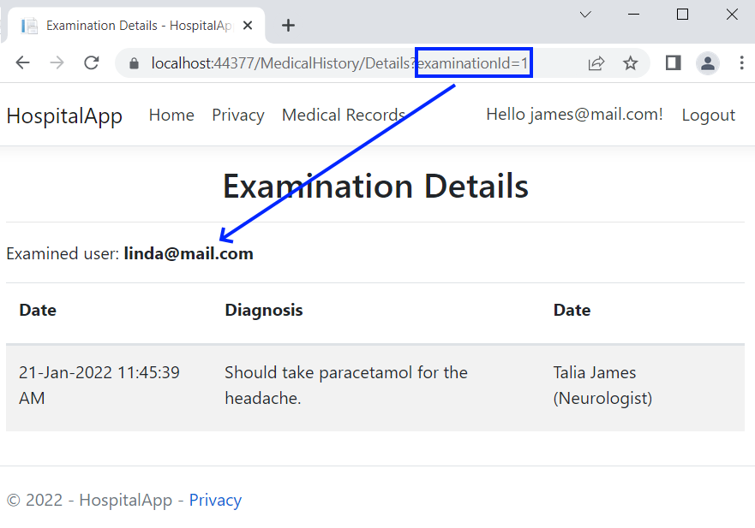
Parameter Tampering – Demo
We have a simple app, which displays data by ID
Without checking the permissions
A hacker can change the examination ID in the URL
And access other users' data
Demo code: see the resources
Unauthorized user

Slide 35
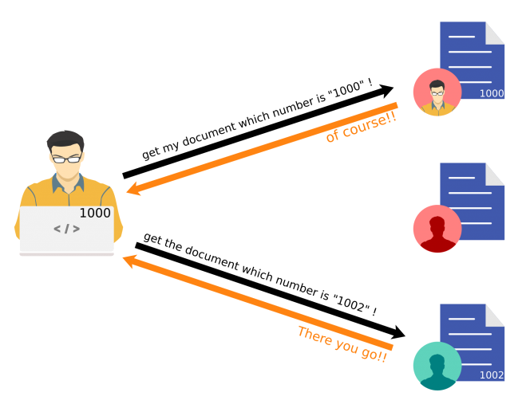
Parameter Tampering: How to Protect?
Check the input parameters before accessing the database
The forms on the site should have some built-in protection
Using regex to limit or validate data
Avoid unwanted or hidden data
Encrypt the session cookies

Slide 36
Protect from Parameter Tampering – Sample Code
Code, vulnerable to parameter tampering:
Add explicit checks to secure the code
var examination = this.data.Examinations.Include(ex => ex.Patient)
.FirstOrDefault(ex => ex.Id == examinationId);
if(examination == null) return RedirectToAction("Summary");
var currentLoggedUserId = this.User
.FindFirstValue(ClaimTypes.NameIdentifier);
if (examination.PatientId != currentLoggedUserId) return Unauthorized();
var model = new ExaminationRecord() { … };
return View(model);

Slide 37

Summary
Common security problems
Cross-Site Scripting – attackers inject malicious scripts
SQL Injection – attackers interfere with app queries to the db
Cross-Site Request Forgery – attackers force users to execute unwanted actions on web apps that they are logged-in
Parameter Tampering – attackers manipulate parameters, exchanged between client and server
…
…
…

Slide 38
Questions?
Notes:
38

Slide 39











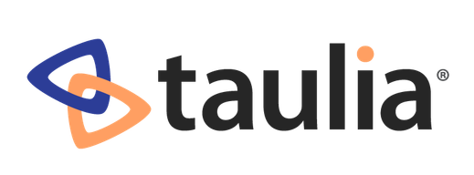

SoftUni Diamond Partners

Slide 40

Educational Partners

Slide 41
Trainings @ Software University (SoftUni)
Software University – High-Quality Education, Profession and Job for Software Developers
softuni.bg, softuni.org
Software University Foundation
softuni.foundation
Software University @ Facebook
facebook.com/SoftwareUniversity
Software University Forums
forum.softuni.bg
Notes:
41

Slide 42

License
This course (slides, examples, demos, exercises, homework, documents, videos and other assets) is copyrighted content
Unauthorized copy, reproduction or use is illegal
© SoftUni – https://softuni.org
© Software University – https://softuni.bg
Notes:
42

